Slide 1
Predicting Movie Revenue
CSE 351
Jeffrey Zhang Oliver Liu Zhe Zhou

Slide 2
Introduction
-Film industry is developing rapidly, the movie revenue is growing.
-There are many factors affecting the revenue of a film.
-We have built a few data-driven (not ad hoc) models to predict revenue.

Slide 3
Exploratory Data Analysis

Slide 4
Clean and Reformat the Dataset
Clean the Dataset:
The outliers and anomalies that are caused by artifacts have to be removed first
The values of budget and revenue are not supposed to be zero.
The movie whose runtime is zero will be deleted from the dataset.
The movies whose “original_title”, “cast”, and “crew” are empty will be removed.
The movies that does not have “production_companies” and “production_countries” are also removed.
Reformat the Dataset:
Some of columns contain dictionaries, and we extract significant information from these dictionaries and reformat them as a string list.
Therefore, we are able to apply some conditions and functions more easily.

Slide 5
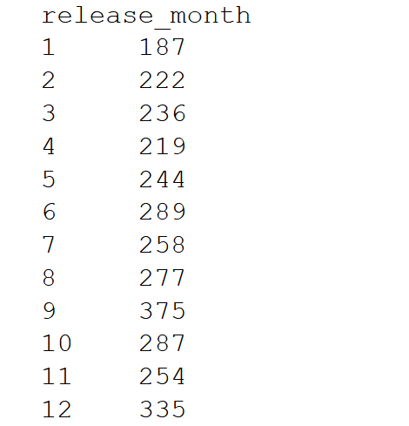
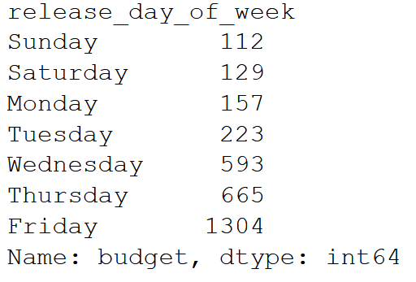
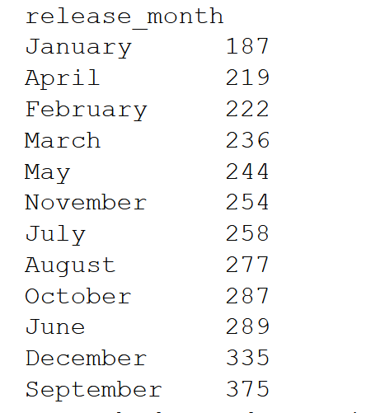
Release day trends
Fridays are popular
Probably anticipating good turnout on friday night / weekends
No particular trend with release months.

Slide 6
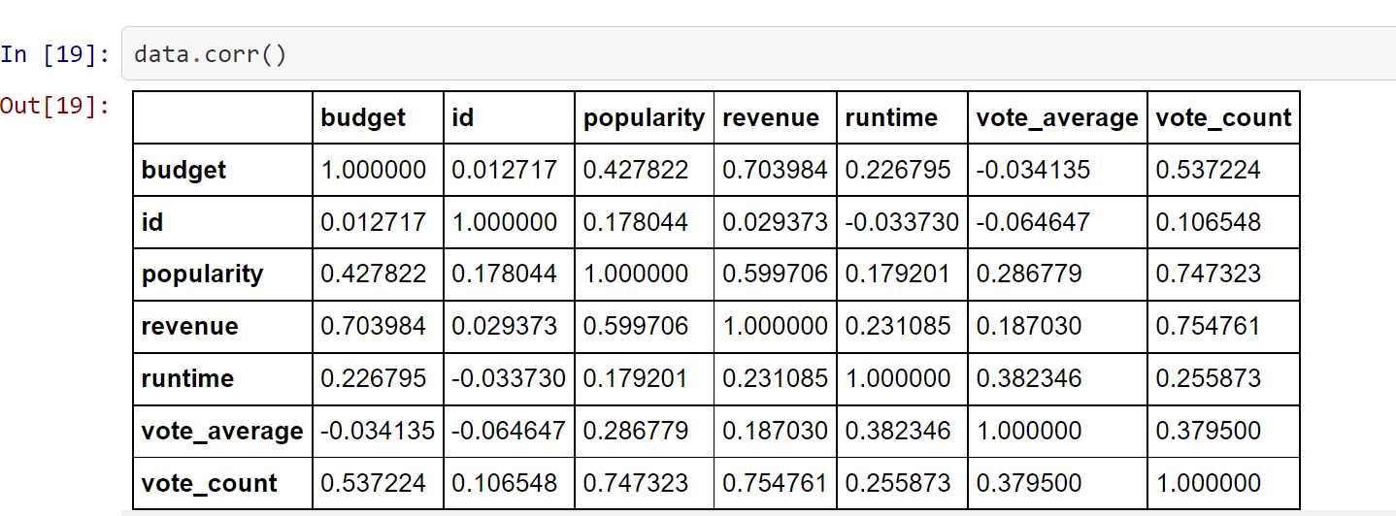
Correlations
We are interested in predicting the revenue.
Budget looks like a good predictor, runtime, not so much
popularity and voting can only know after the release of a movie, so not so useful

Slide 7
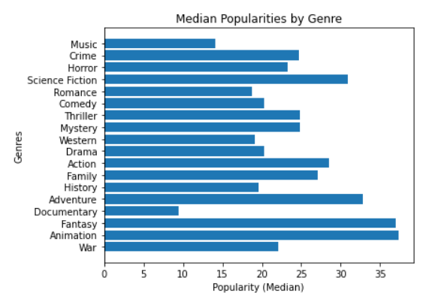
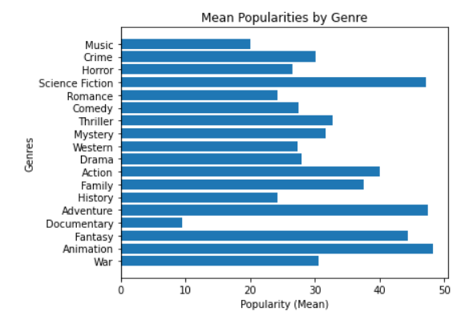
Movie Genre Trend Shifting Patterns
From my interpretation, this means that we are looking for the movie genre that’s popularity an outlier of the dataset.
From looking at both charts, we can determine that documentaries is the movie genre that is farthest away from all other genres since there are no popularities from other genres that are remotely close to it.

Slide 8
Modeling and Question Answering

Slide 9
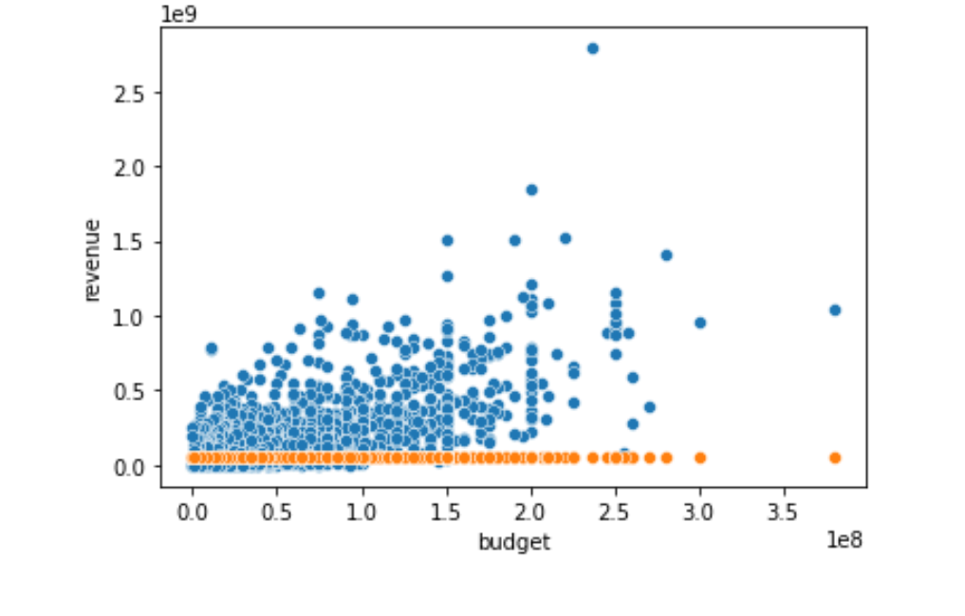
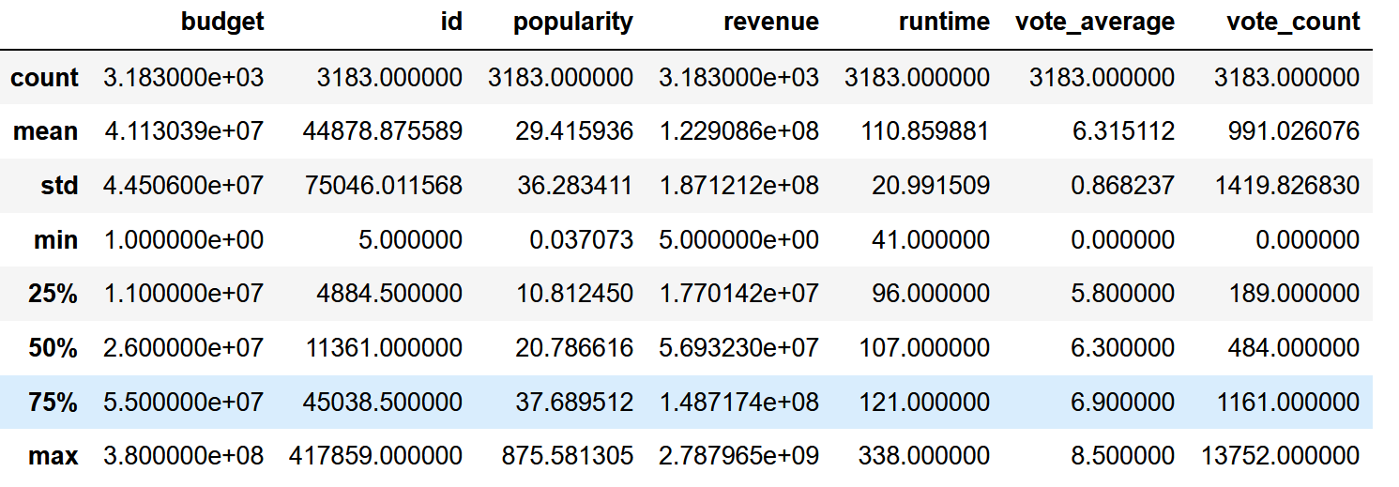
Prediction Baseline
Predicting using mean/median
‘Avg error’ = RMSD:
Predicting mean = std dev. = 187 million USD
Predicting median = 165 million USD
High percent error compared to mean, and median revenue, 122 millon and 57 million respectively

Slide 10
Discussion on RMSE
RMSE of $165 million can be interpreted as such: Our prediction will be off by $165 million on average.
Very sensitive to outliers
We have lots of outliers in our set
Perhaps we could use the ‘medain’ error instead of the average error.
However, as RMSE is a standard metric, we will go with it.

Slide 11
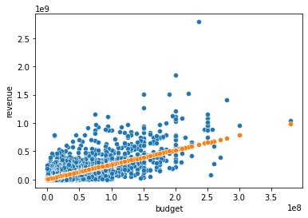
Standard Linear Regression Model
-Before training the model, we separated the dataset into a training set and a test set and then we need to use the fit function to generate an appropriate linear regression model.
-We apply the Cross-Validation to make sure our predictions more accurate.
The Final Model:
Revenue =
2.57 * Budget + $12 Million
From the table and heat map, we find the correlation coefficient between budget and revenue is highest.
Therefore, we want to build a linear regression model between them.
Blue: Data Points
Orange: Trendline (Predictions)

Slide 12
Accuracy of Standard Linear Regression Model
RMSE = $113 Million
Our prediction will be off by $113 Million on average
Not spectacular, but certainly beats our baseline of $165 Million

Slide 13

Unsuccessful:
Applying a transformation to revenue, then fitting linear regression
Note slightly curved line
budget ^1.25 worked the best, but was only 2.2 percent improvement
Doesn’t pass Occam’s Razor
Also tried budget squared, cubed, square root, etc

Slide 14
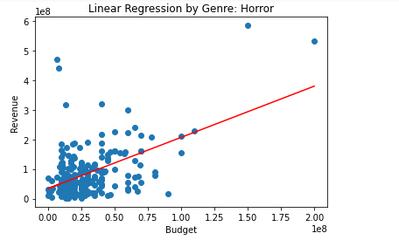

Grouping By Genre without Cross Validation
For this model, we split the movies into their respective genres to generate more linear equations.
This determines is determined by the training data.
As a result, some genres had low MSEs and some had high MSEs.
An example of a low MSE genre can be the horror genre.

Slide 15
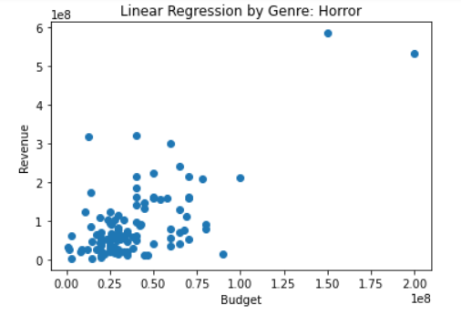
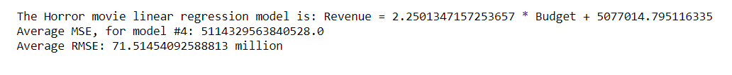
Grouping By Genre With Cross Validation
In an attempt to improve on the models grouped by genre, we apply cross validation.
However, this was a failure in most genres as both the MSE and RMSE increased.
On the other hand, as expected, the MSE and RMSE of horror movies improved minorly by 2*10^114 in MSE and 1 million in RMSE.

Slide 16
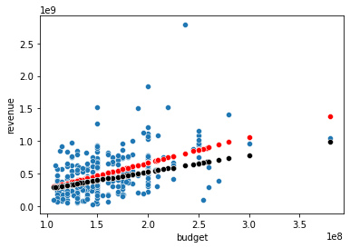

Limited Success- Grouping by budget
Budget Classes , under 15 million USD, 15 million - 105 million USD, and Over 105 million USD, and train on each.
Almost identical for movies with budget under 105 million USD
Over 105 million Model 1 RMSE: 312 million
where training on data3 alone 292 million
so that gave a 6.4 percent improvement, perhaps still not enough to pass Occam's Razor Test.
High budget movies -
Model 1 trendline is red
2.57 x budget+12.17million
Exclusively trained trendline is black
3.95 x budget - 125.59 million

Slide 17

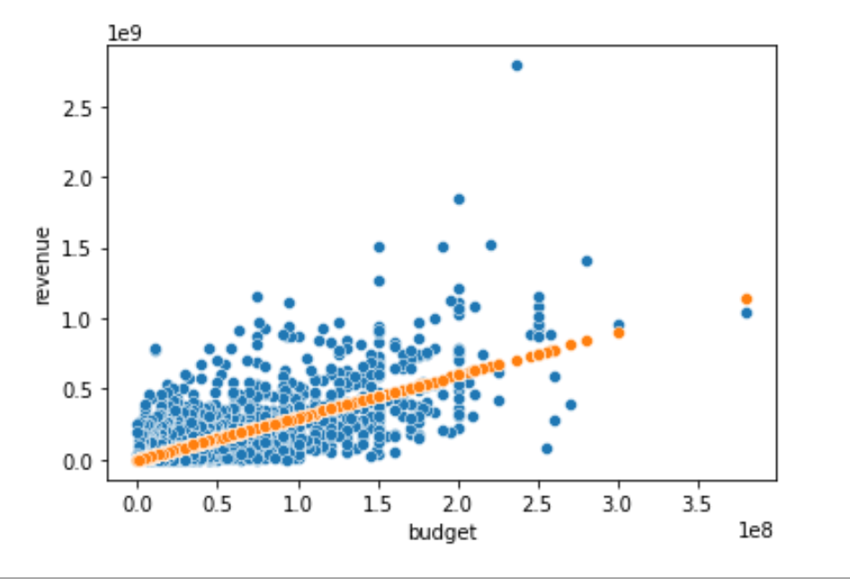
A Very Simple Model (You can calculate in your head / The average 15 year old could understand)
2.57 x budget+12.17million
3.95 x budget - 125.59 million
How about: Revenue = 3 x Budget ?
Easily Passes Occam’s Razor

Slide 18
Simple Analysis
Profit = Revenue - Budget
Revenue = 3 x Budget (± $42 Million)
Profit = 3 x Budget - Budget
Profit = 2 x Budget
Expected ROI = (Profit / Cost) = 200%
Ex. $50 million budget movie
Revenue = $ 50 Million x 3 = $ 150 Million (± $42 Million)
Profit = $100 Million Dollars (± $42 Million)
Median error of prediction is 42 Million
But perhaps keep in mind this may not apply to “home-made movies”

Slide 19

Final point
Why not able to build a more accurate model?

Slide 20
How to improve our models?
Revenue, although r=0.7 correlated with revenue, can only predict so much
Perhaps ad hoc models, will be more accurate
Consider actors (Pitt, Jolie, Hanks...), directors (Christopher Nolan, Steven Spielberg), franchises (Star Wars, Harry Potter, etc.)
The final model cannot provide accurate predictions, and we think the reason is that we do not apply other features such as genres, production companies to the model.
For example, if we have two movies that have same budgets, but they are produced by different production companies. One of them is produced by Marvel, but the other one is produced by an unknown company. Hence, the possibility that the movie produced by Marvel will have a higher revenue than the other one.
Hence, the other variables also play significant roles in movies' revenue.

Slide 21
Not able to build a perfect model,
But,
able to build a useful model.

Slide 22
“All models are wrong, but some models are useful.”
- George Box (1919-2013)

Slide 23

Thanks!

